Slide 1
UT Southwestern Medical Center Accredited Provider Unit NCPD Nurse Planner Orientation Session 4
10.20.2022
Notes:
Welcome to the first session of our Nurse Planner Orientation.
Today will review our relationship with ANCC and how it drives our work.
In addition, we will review how our provider unit is structured.

Slide 2
Disclosure to Learners
UT Southwestern Medical Center is accredited as a provider
of nursing continuing professional development
by the American Nurses Credentialing Center’s
Commission on Accreditation.
Requirements for successful completion:
Attend the entire event
Complete and submit the evaluation
Relevant Financial Relationships:
This is a non-clinical activity. Therefore, no relevant financial relationships with ineligible companies are needed for those involved with the ability to control the content of this activity.
Learning Outcome: After participating in this activity, 75% of the learners who complete the evaluation will self-report an increase in knowledge and intent to change nurse planner practice regarding the topic covered.
This activity provides 1.0 contact hour(s).
Notes:
ANCC has new language for conflicts of interest. It is now called relevant financial relationships. ANCC worked with the CME accrediting body to create the same requirements regardless of type of credit being offered.
ANCC requires we disclose to learners all relevant financial relationships prior to sharing any content.

Slide 3
Recap Session 2
What do you recall from Session 2?

Slide 4
Recap Session 2
Education Design Process (EDP)
Fundamentals of High-Quality EDP
Current State
Desired State
Professional Practice Gap (PPG)

Slide 5
NCPD Design Process Components
Needs Assessment
Professional Practice Gap
Planning Committee
Underlying Education Needs
Target Audience
Learning Outcomes
Content for NCPD Activity
Active Learner Engagement
Criteria for Awarding Contact Hours
Evaluation
Independence from Commercial Interest Organizations

Slide 6
Planning Committee
Who is part of the planning committee?
CEPD Nurse Planner
Content Expert
If CEPD Nurse Planner is also the content expert, another person needs to be on the planning committee

Slide 7
Planning Committee
Keep it small
In charge of needs assessment, design, development, implementation, and evaluation of activity
Partners in completion of ANCC required forms
Reviews Summative Evaluation results for any needed course changes

Slide 8
Underlying Education Needs
Identify a professional practice gap
Conduct a needs assessment
determines the underlying NCPD needs of the target audience
The Nurse Planner and Planning Committee evaluate what the target audience:
does not know (knowledge deficit)
does not know how to do (skill deficit)
is not able to do in practice (practice deficit)

Slide 9
Evidence of a Professional Gap
Survey data from stakeholders, target audience members, subject matter experts or similar
Input from stakeholders such as learners, managers, or subject matter experts
Evidence from quality studies and/or performance improvement activities to identify opportunities for improvement.
Evaluation data from previous education activities
Trends in literature
Direct observation

Slide 10
Backward Activity Planning
Backward-planning process to determine the NCPD needs and targeting the NCPD activity appropriately to address the gap.
Determine desired learning outcome
What is acceptable evidence
Design and develop the activity content

Slide 11
Backward Activity Planning
Backward Design Process (License CC 4.0 BY NC SA, Peter Mazohl, 2021)

Slide 12
Target Audience
Determine who should receive the training
Training is designed to meet the target population
Needs to include nurses

Slide 13
Learning Outcomes
Developed for the target audience
What the learner will be able to do as a result of participating in the activity
Must be observable and measurable
Addresses the NCPD needs (knowledge, skills, and/or practices) that contribute to the professional practice gap (PPG)
Should result in narrowing or closing the gap PPG

Slide 14
Learning Outcomes
Current state of practice
Change in practice
Problem in practice
Opportunity for improvement

Slide 15
Examples
Nurses do not know how to perform a beside open chest procedure
Nurses on 10G do not have the up to date transplant guidelines
New oncology nurses are unable to administer chemotherapy

Slide 16
Learning Outcomes
Desired state of practice
What/how you want the learner to perform

Slide 17
Examples
Nurses will know how to perform a beside open chest procedure
Nurses on 10G will have the up to date transplant guidelines
New oncology nurses are able to administer chemotherapy

Slide 18
Learning Outcomes
What is the professional practice gap
Evaluate the root causes of the gap, or why the gap exists

Slide 19
Examples
Lack knowledge and skills regarding how to perform a beside open chest procedure
Lack knowledge regarding the up to date transplant guidelines
Lack knowledge, skills and performance to administer chemotherapy

Slide 20
Learning Outcomes
Desired Learning Outcome
What will the outcome be as a result of participation in this activity?

Slide 21
Examples
Increased knowledge and skills regarding how to perform a beside open chest procedure
Increased knowledge regarding the up to date transplant guidelines
Increased knowledge, skills and performance to administer chemotherapy

Slide 22
Learning Outcomes
Learning Outcome Measure
Quantitative statement as to how the outcome will be measured

Slide 23
Examples
After participating in this activity, 75% of the learners who complete the evaluation will self-report an increase in…
knowledge and skills regarding how to perform a beside open chest procedure
knowledge regarding the up to date transplant guidelines
knowledge, skills and performance to administer chemotherapy

Slide 24
Example - Knowledge
After participating in this activity, 75% of the learners who completed the evaluation will self-report a change in knowledge and intent to change practice regarding the topic covered.

Slide 25
Example - Skill
After participating in this activity, 75% of the learners who completed the evaluation will self-report a change in skill level and intent to change practice regarding the topic covered.

Slide 26
Example: Learning Outcome Measures
Please provide examples of learning outcomes you have created in the past which were measurable.

Slide 27
Example: Learning Outcome Measures
What changes would you make to your practice after receiving this information?

Slide 28
Wrap Up
Discussion
Questions
Next Steps for Series
Next Steps for receiving contact hours

Slide 29
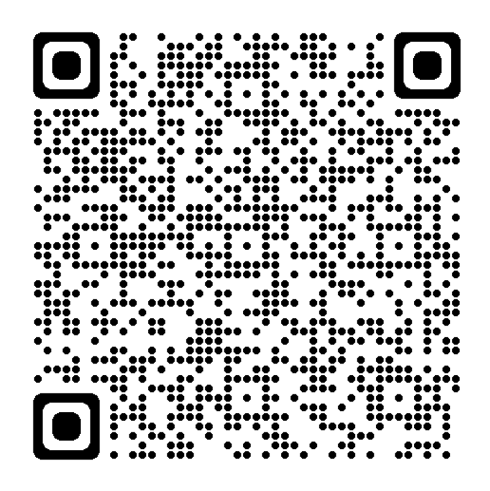
Evaluation Access

